Slide 1
Object Oriented Programming in JAVA

Slide 2
Introduction
Welcome to the course Object Oriented Programming in JAVA. This course will cover a core set of computer science concepts needed to create a modern software application using Java.

Slide 3
Course Objectives
On completion of this course we will be able to:
Identify the importance of Java .
Identify the additional features of Java compared to C++ .
Identify the difference between Compiler and Interpreter .
Identify the difference between applet and application .
Apply Object Oriented Principles of Encapsulations, Data abstraction, Inheritance, Polymorphism.
Program using java API (Application Programming Interface).
Program using Exception Handling, Files and Threads .
Program Using applets and swings .

Slide 4
Course Syllabus
UNIT | CONCEPTS to be covered
UNIT-I | JAVA Basics
UNIT-II | Inheritance
UNIT-III | Data structures creation and manipulation in java
UNIT-IV | Exception Handling
UNIT-V | GUI Programming With JAVA

Slide 5
JAVA Basics

Slide 6
Why Java is Important
Two reasons :
Trouble with C/C++ language is that they are not portable and are not platform independent languages.
Emergence of World Wide Web, which demanded portable programs
Portability and security necessitated the invention of Java

Slide 7
History
James Gosling - Sun Microsystems
Co founder – Vinod Khosla
Oak - Java, May 20, 1995, Sun World
JDK Evolutions
JDK 1.0 (January 23, 1996)
JDK 1.1 (February 19, 1997)
J2SE 1.2 (December 8, 1998)
J2SE 1.3 (May 8, 2000)
J2SE 1.4 (February 6, 2002)
J2SE 5.0 (September 30, 2004)
Java SE 6 (December 11, 2006)
Java SE 7 (July 28, 2011)
Notes:
Java was conceived by james gosling,patrick naughton….
Java was initially called as Oak..
But renamed as java in 1995
Standard edition, management edition, enterprise edition (used for adv.. Java concepts)
You can write the java program in any editors, notepads. But it will be easy if you use editplus

Slide 8
Cont..
Java Editions.
J2SE(Java 2 Standard Edition) - to develop client-side standalone applications or applets.
J2ME(Java 2 Micro Edition ) - to develop applications for mobile devices such as cell phones.
J2EE(Java 2 Enterprise Edition ) - to develop server-side applications such as Java servlets and Java ServerPages.

Slide 9
What is java?
A general-purpose object-oriented language.
Write Once Run Anywhere (WORA).
Designed for easy Web/Internet applications.
Widespread acceptance.
Notes:
Due to the simillarities of java with C++ it si called “Internet version of C++”
Based on C/C++

Slide 10
How is Java different from C…
C Language:
Major difference is that C is a structure oriented language and Java is an object oriented language and has mechanism to define classes and objects.
Java does not support an explicit pointer type
Java does not have preprocessor, so we cant use #define, #include and #ifdef statements.
Java does not include structures, unions and enum data types.
Java does not include keywords like goto, sizeof and typedef.
Java adds labeled break and continue statements.
Java adds many features required for object oriented programming.

Slide 11
How is Java different from C++…
C++ language
Features removed in java:
Java doesn’t support pointers to avoid unauthorized access of memory locations.
Java does not include structures, unions and enum data types.
Java does not support operator over loading.
Preprocessor plays less important role in C++ and so eliminated entirely in java.
Java does not perform automatic type conversions that result in loss of precision.

Slide 12
Cont…
Java does not support global variables. Every method and variable is declared within a class and forms part of that class.
Java does not allow default arguments.
Java does not support inheritance of multiple super classes by a sub class (i.e., multiple inheritance). This is accomplished by using ‘interface’ concept.
It is not possible to declare unsigned integers in java.
In java objects are passed by reference only. In C++ objects may be passed by value or reference.

Slide 13
Cont …
New features added in Java:
Multithreading, that allows two or more pieces of the same program to execute concurrently.
C++ has a set of library functions that use a common header file. But java replaces it with its own set of API classes.
It adds packages and interfaces.
Java supports automatic garbage collection.
break and continue statements have been enhanced in java to accept labels as targets.
The use of unicode characters ensures portability.

Slide 14
Cont …
Features that differ:
Though C++ and java supports Boolean data type, C++ takes any nonzero value as true and zero as false. True and false in java are predefined literals that are values for a boolean expression.
Java has replaced the destructor function with a finalize() function.
C++ supports exception handling that is similar to java's. However, in C++ there is no requirement that a thrown exception be caught.

Slide 15
Characteristics of Java
Java is simple
Java is object-oriented
Java is distributed
Java is interpreted
Java is robust
Java is architecture-neutral
Java is portable
Java’s performance
Java is multithreaded
Java is dynamic
Java is secure

Slide 16
Java Environment
Java includes many development tools, classes and methods
Development tools are part of Java Development Kit (JDK) and
The classes and methods are part of Java Standard Library (JSL), also known as Application Programming Interface (API).
JDK constitutes of tools like java compiler, java interpreter and many.
API includes hundreds of classes and methods grouped into several packages according to their functionality.

Slide 17
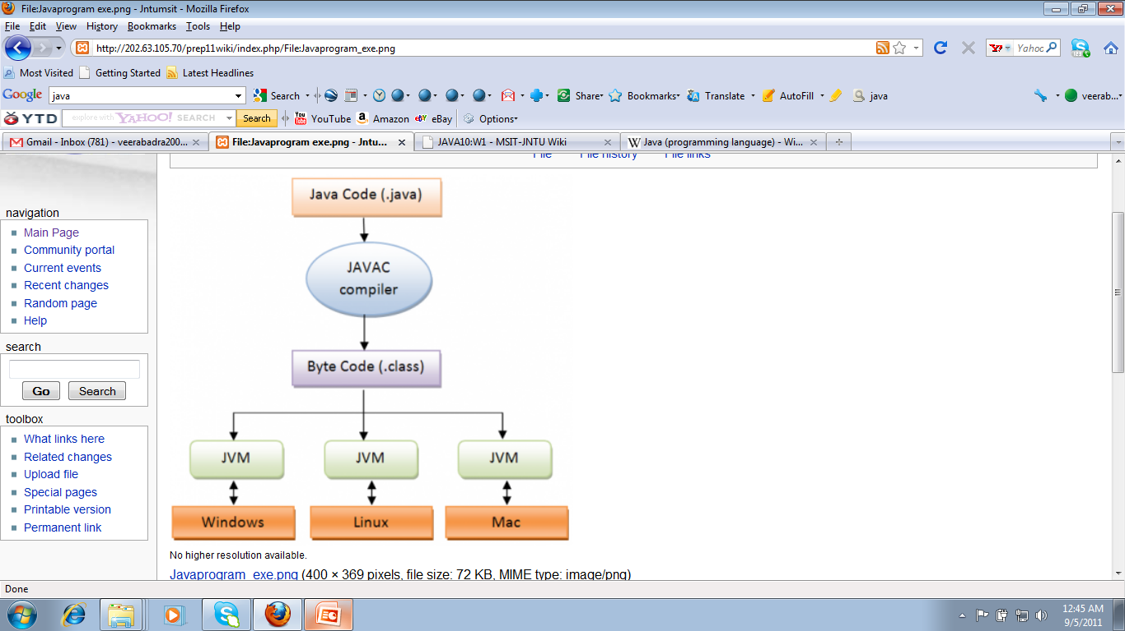
Java is architecture-neutral
JAVA Program Execution

Slide 18
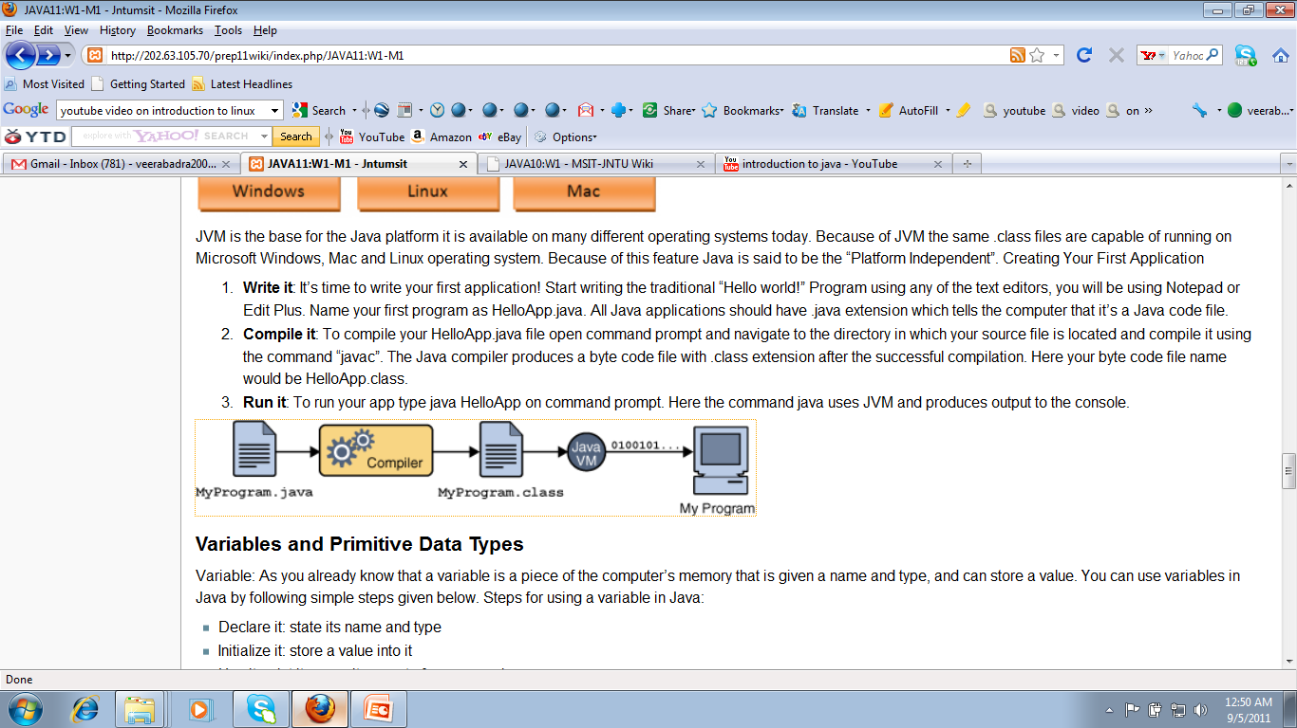
WORA(Write Once Run Anywhere)

Slide 19
Editplus for Java Programming
Edit Plus Software:
EditPlus is a 32-bit text editor for the Microsoft Windows operating system.
The editor contains tools for programmers, including syntax highlighting (and support for custom syntax files), file type conversions, line ending conversion (between Linux, Windows and Mac styles), regular expressions for search-and-replace, spell check etc).

Slide 20
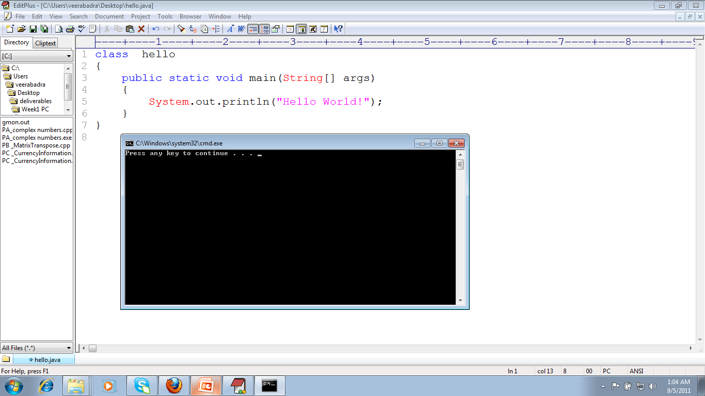
Hello world Program in java

Slide 21
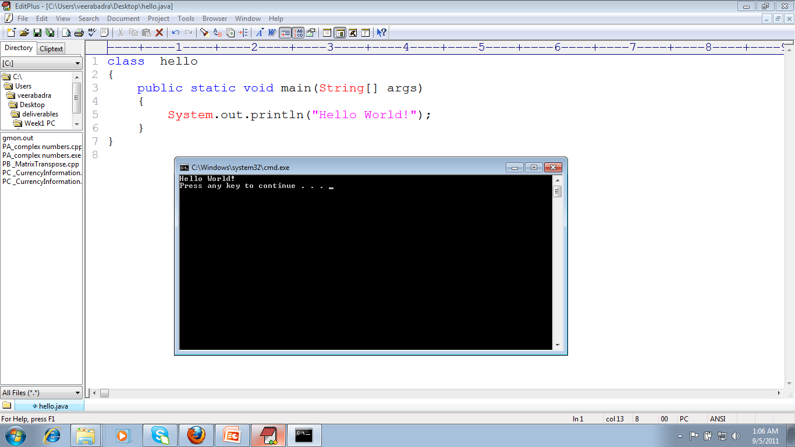
Execution of Hello world Program

Slide 22
Thank you

